Slide 1
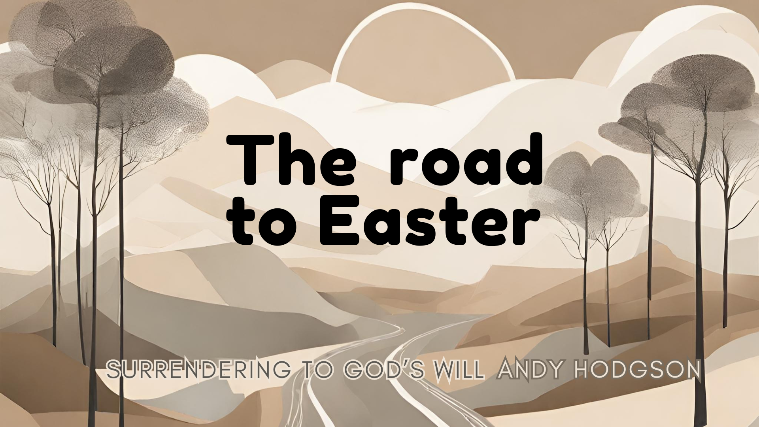

Slide 2
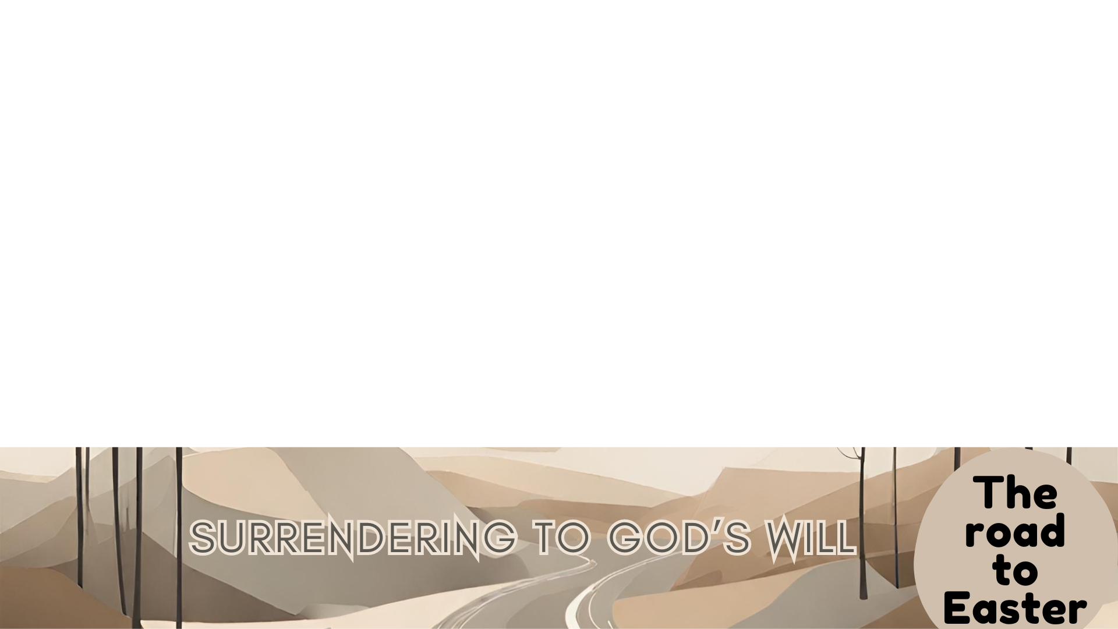
Then Jesus went with them to the olive grove called Gethsemane, and he said, “Sit here while I go over there to pray.” He took Peter and Zebedee’s two sons, James and John, and he became anguished and distressed. He told them, “My soul is crushed with grief to the point of death. Stay here and keep watch with me.”
He went on a little farther and bowed with his face to the ground, praying, “My Father! If it is possible, let this cup of suffering be taken away from me. Yet I want your will to be done, not mine.”
Then he returned to the disciples and found them asleep. He said to

Slide 3
Peter, “Couldn’t you watch with me even one hour? Keep watch and pray, so that you will not give in to temptation. For the spirit is willing, but the body is weak!”
Then Jesus left them a second time and prayed, “My Father! If this cup cannot be taken away unless I drink it, your will be done.” When he returned to them again, he found them sleeping, for they couldn’t keep their eyes open.
So he went to pray a third time, saying the same things again.
MATTHEW 26: 36 - 44

Slide 4
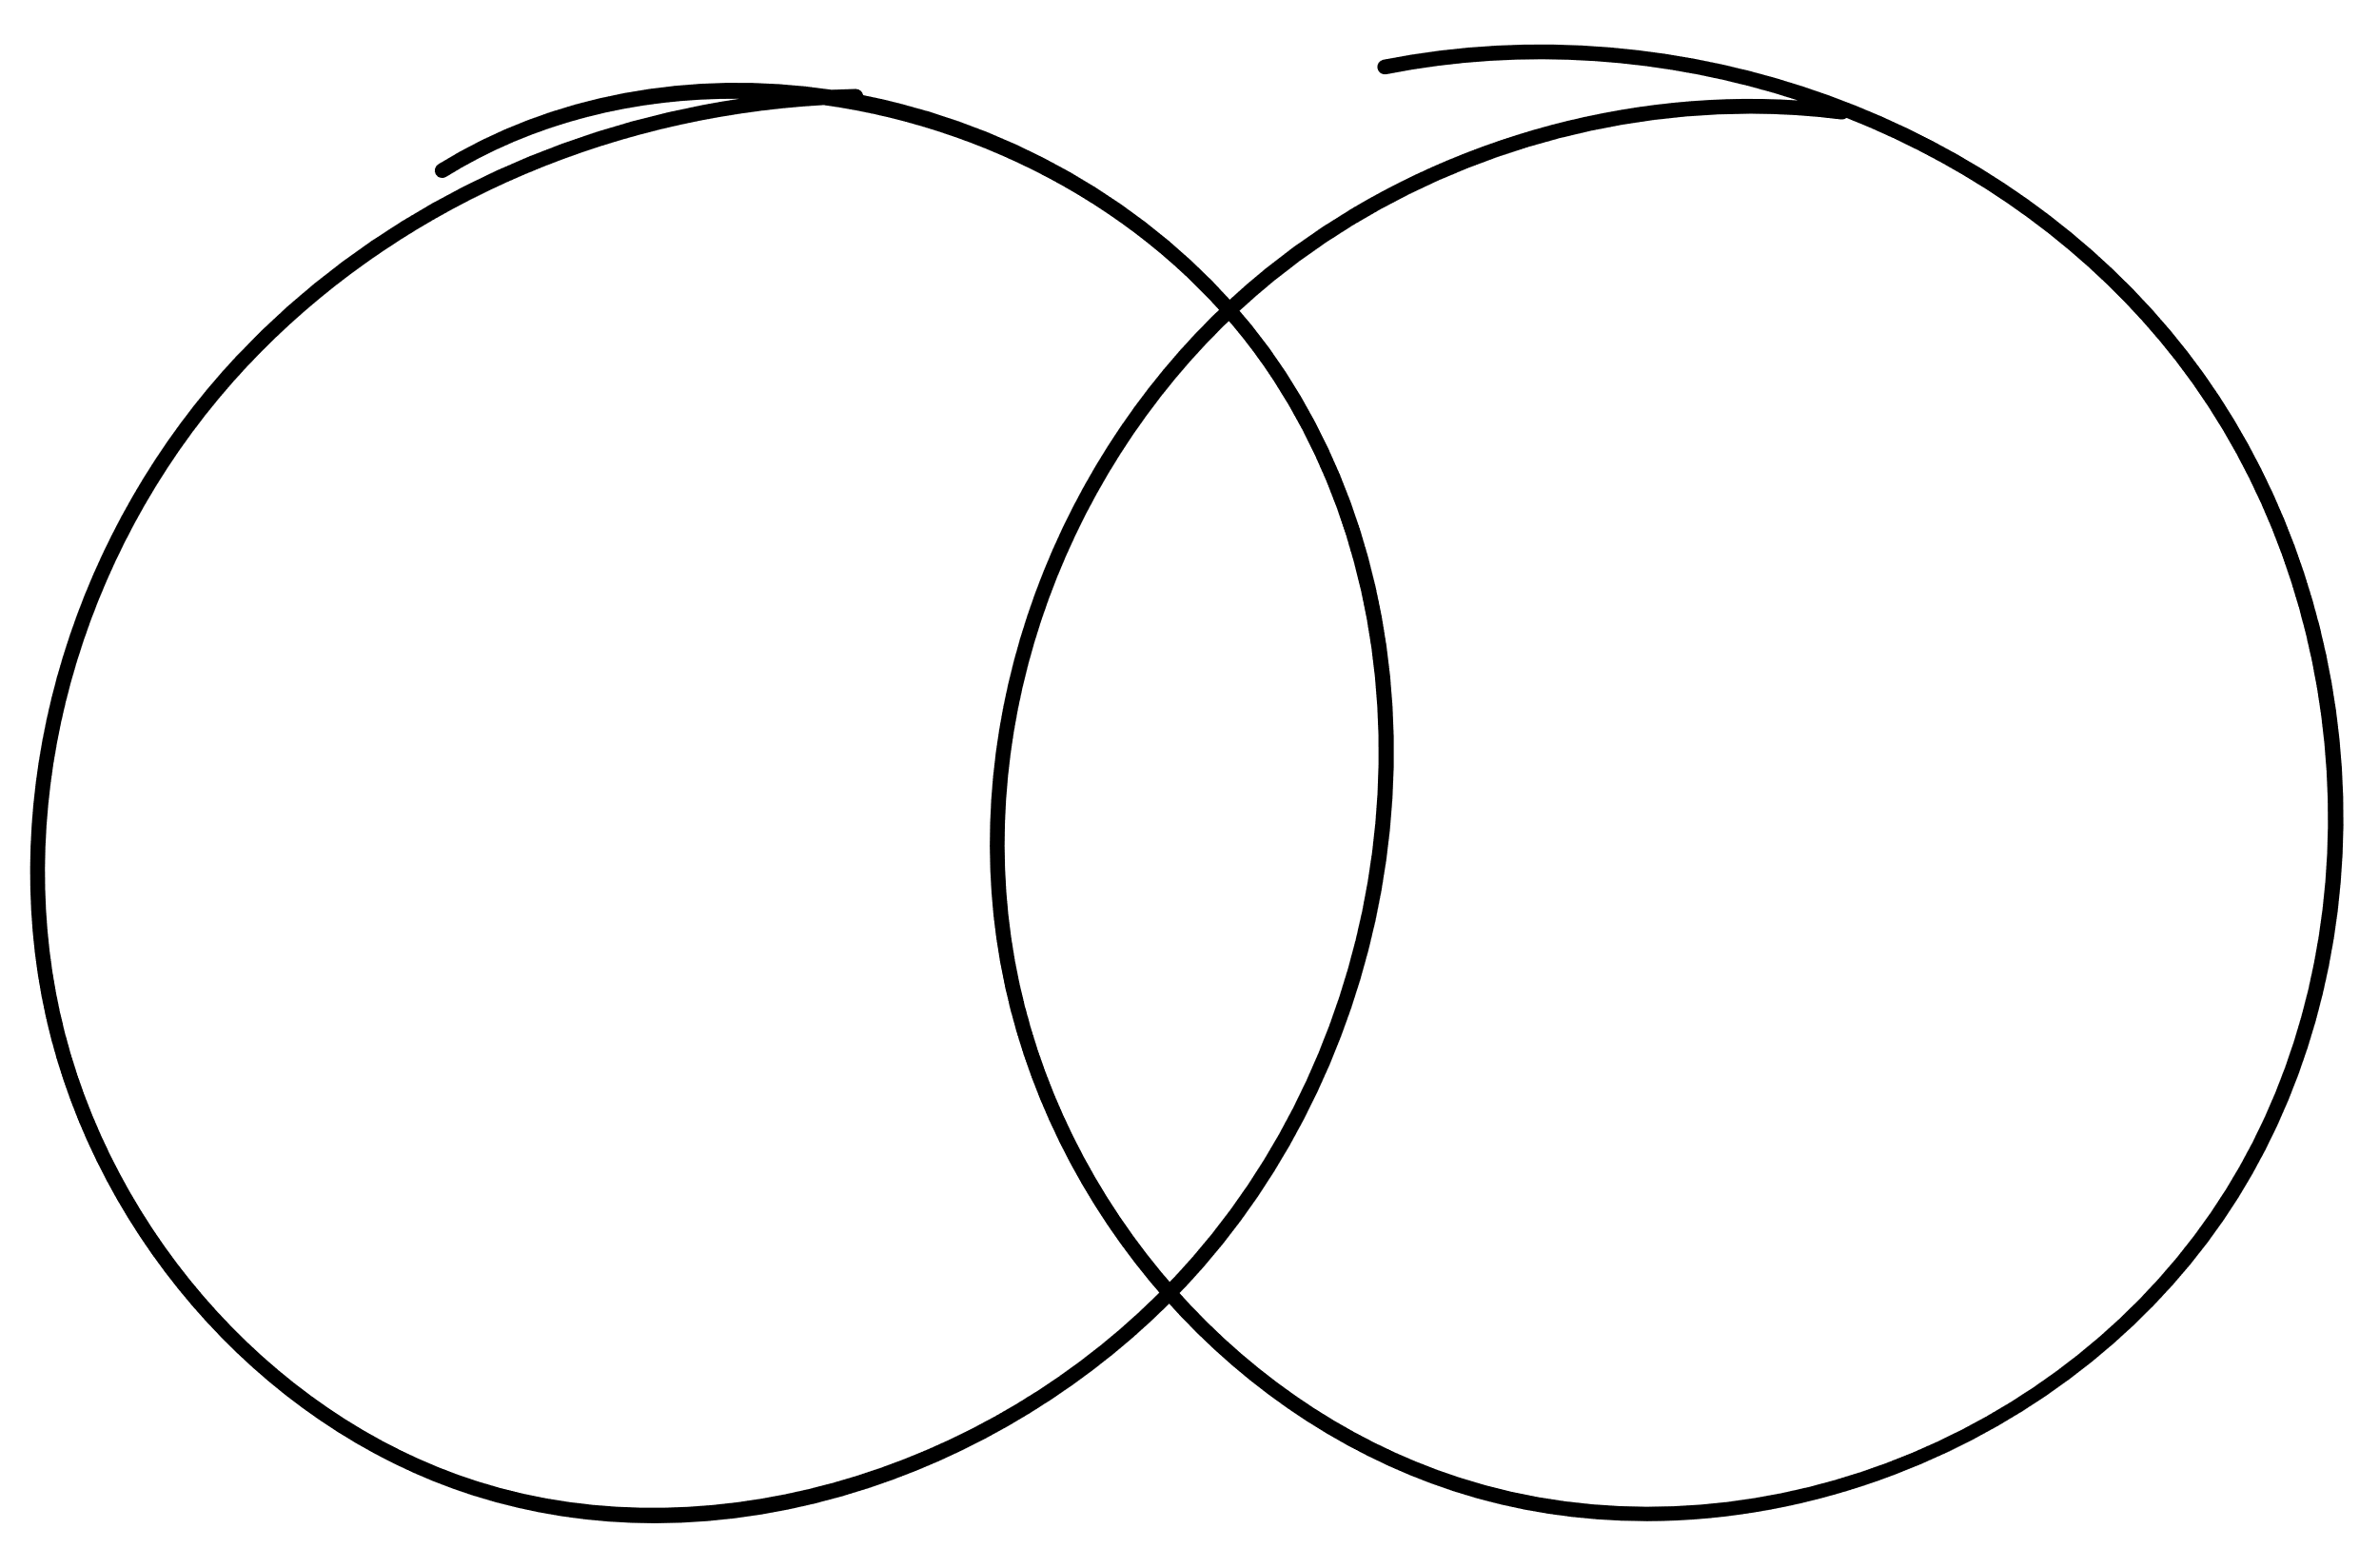
Obedience
Surrender

Slide 5

1 Samual 15: 13-23
  Read the passage together
  What insight does this give you about living in obedience today, this week, and tomorrow?
Matthew 7: 24 – 27
1 John 2: 3-6
John 15: 10-14

Slide 6
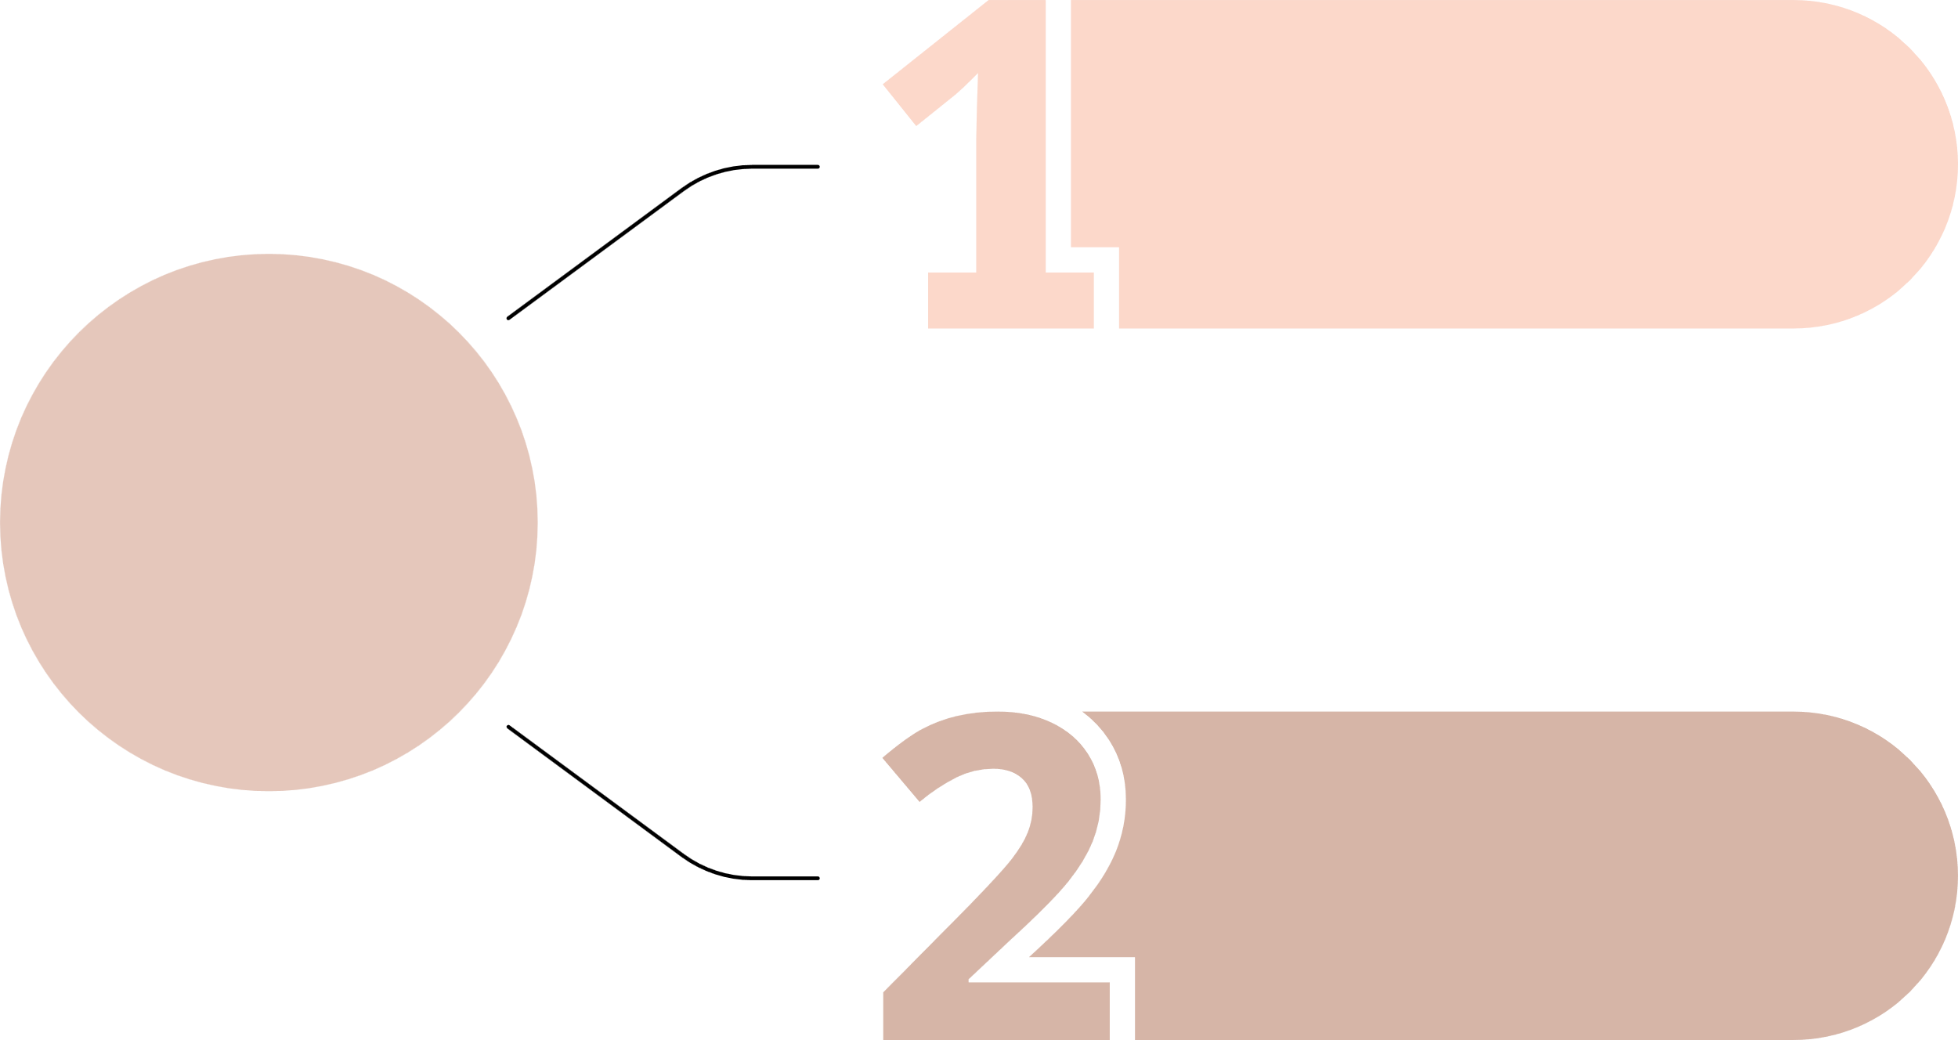
Follow him
Jesus’
Invitation
His will

